Slide 1

Project 4 Group 4 - Xiang Neural Style Transfer walk through & Stable Diffusion Demo through web application & Image Interpolation with Stable Diffusion

Slide 2
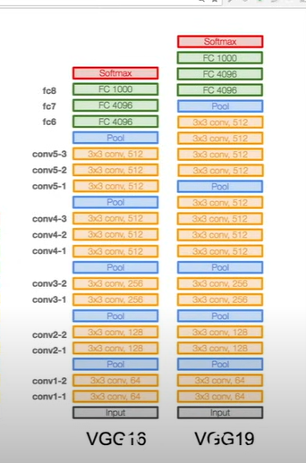
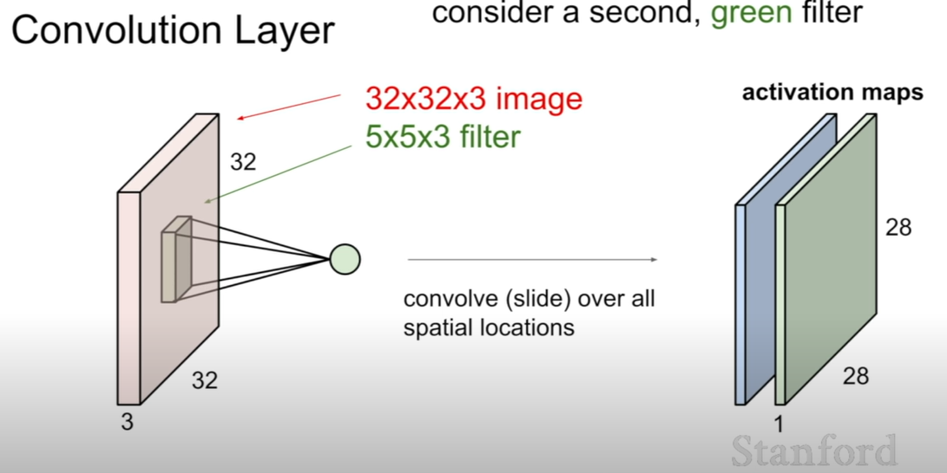
CNN revisit
Conv layer – scan input with a filter of weight matrix
Feature maps – output of the conv layer and input of next
VGG models architectures

Slide 3
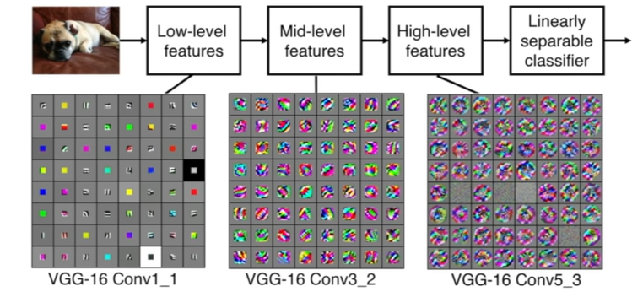
What the input image looks like inside CNN
Copilot:
To learn hierarchical features. Lower layers (from CNN) learn simple, low-level features like edges and colors, while higher layers combine these low-level features to learn more complex, high-level features like shapes or objects.

Slide 4
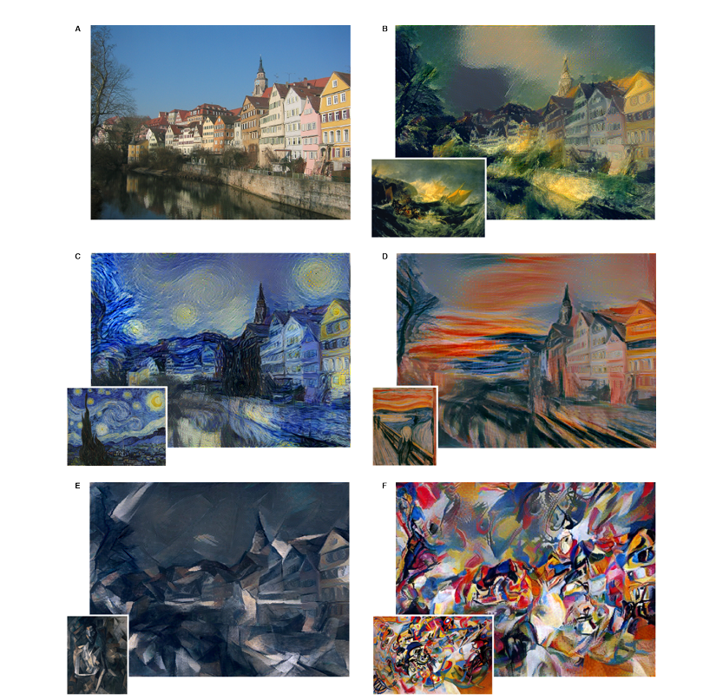
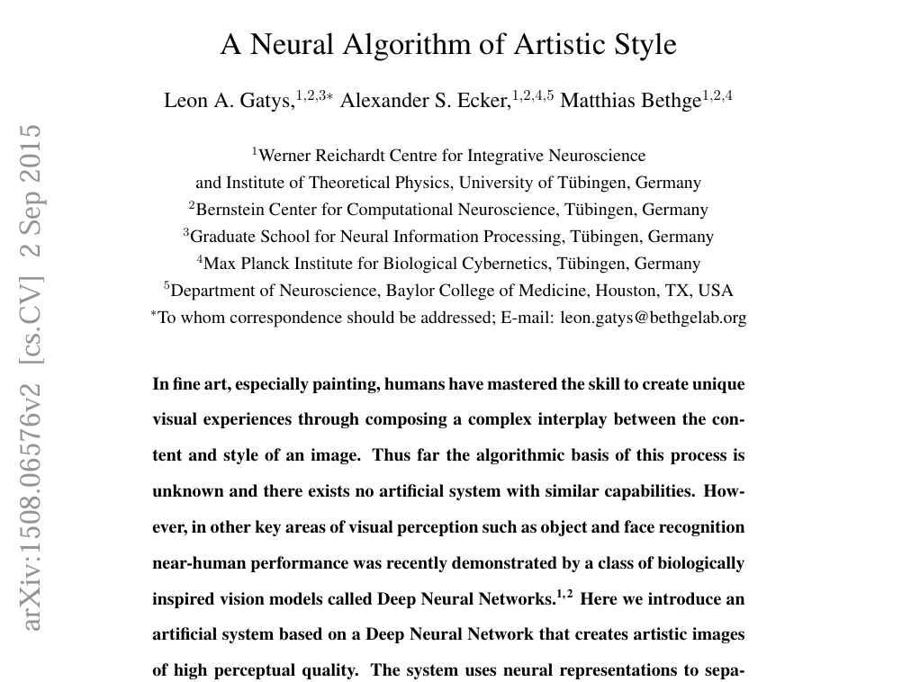
Neural Style Transfer

Slide 5
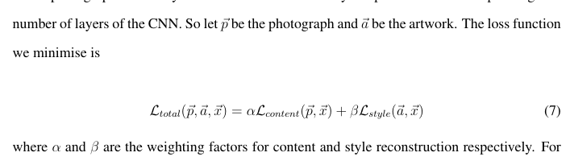
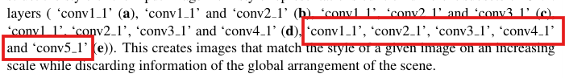
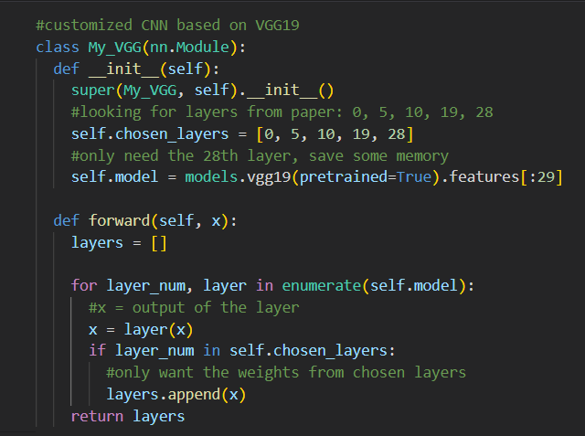
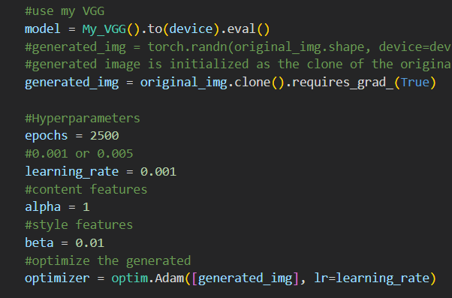

Slide 6
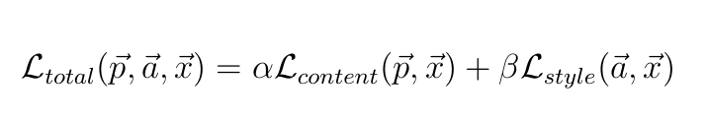
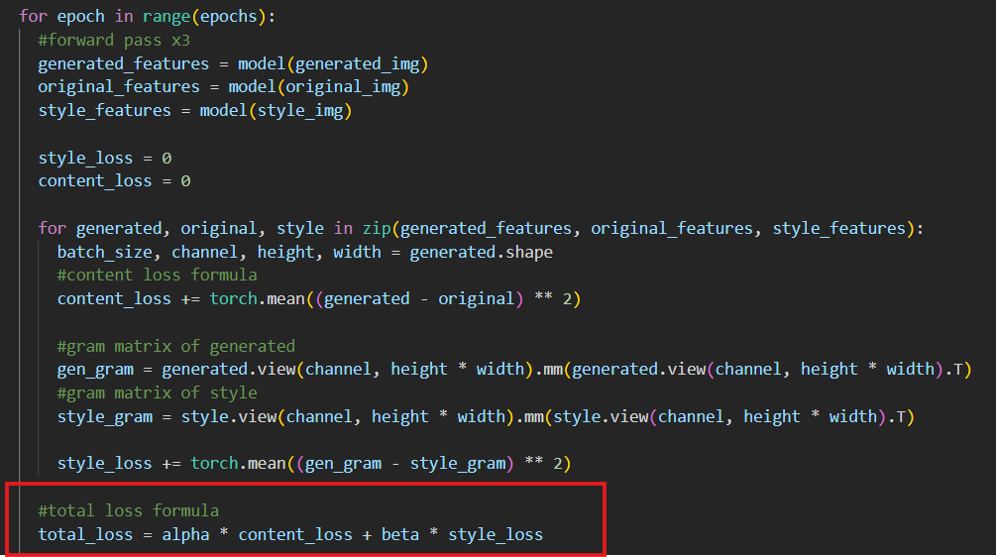
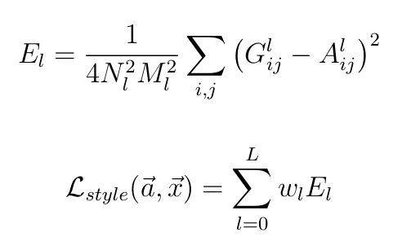
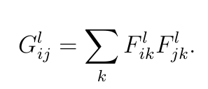
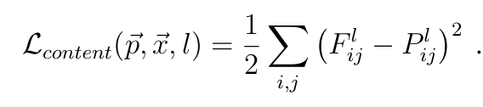
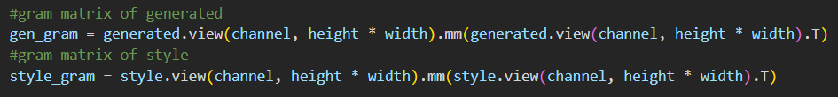
Total Loss Function
Total Style Loss
Gram Matrix
Total Content Loss

Slide 7
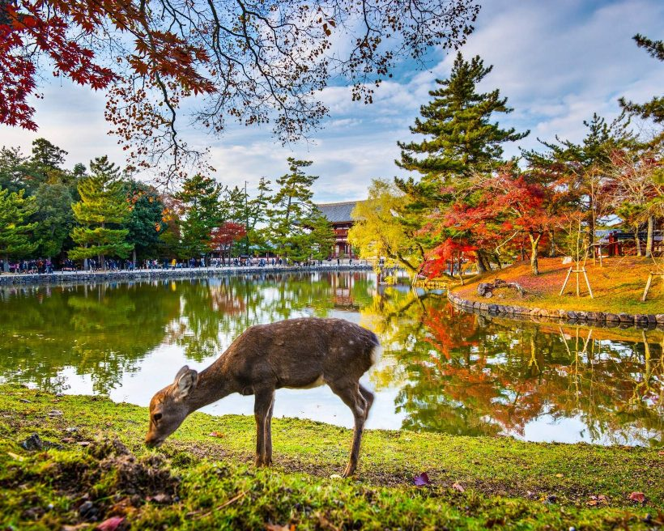
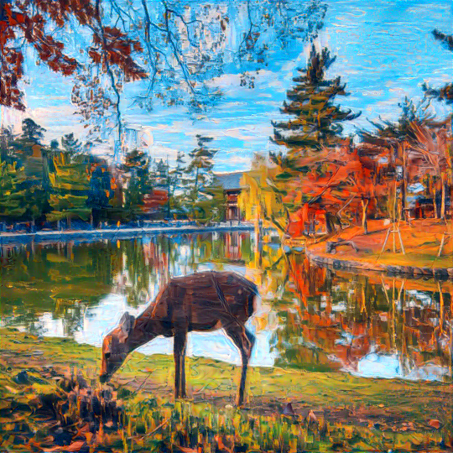
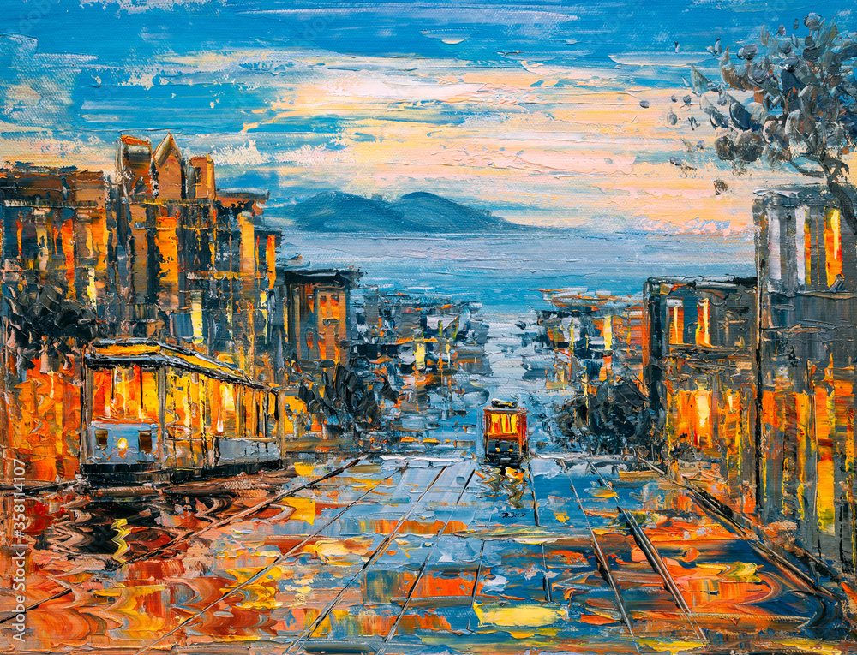

Slide 8
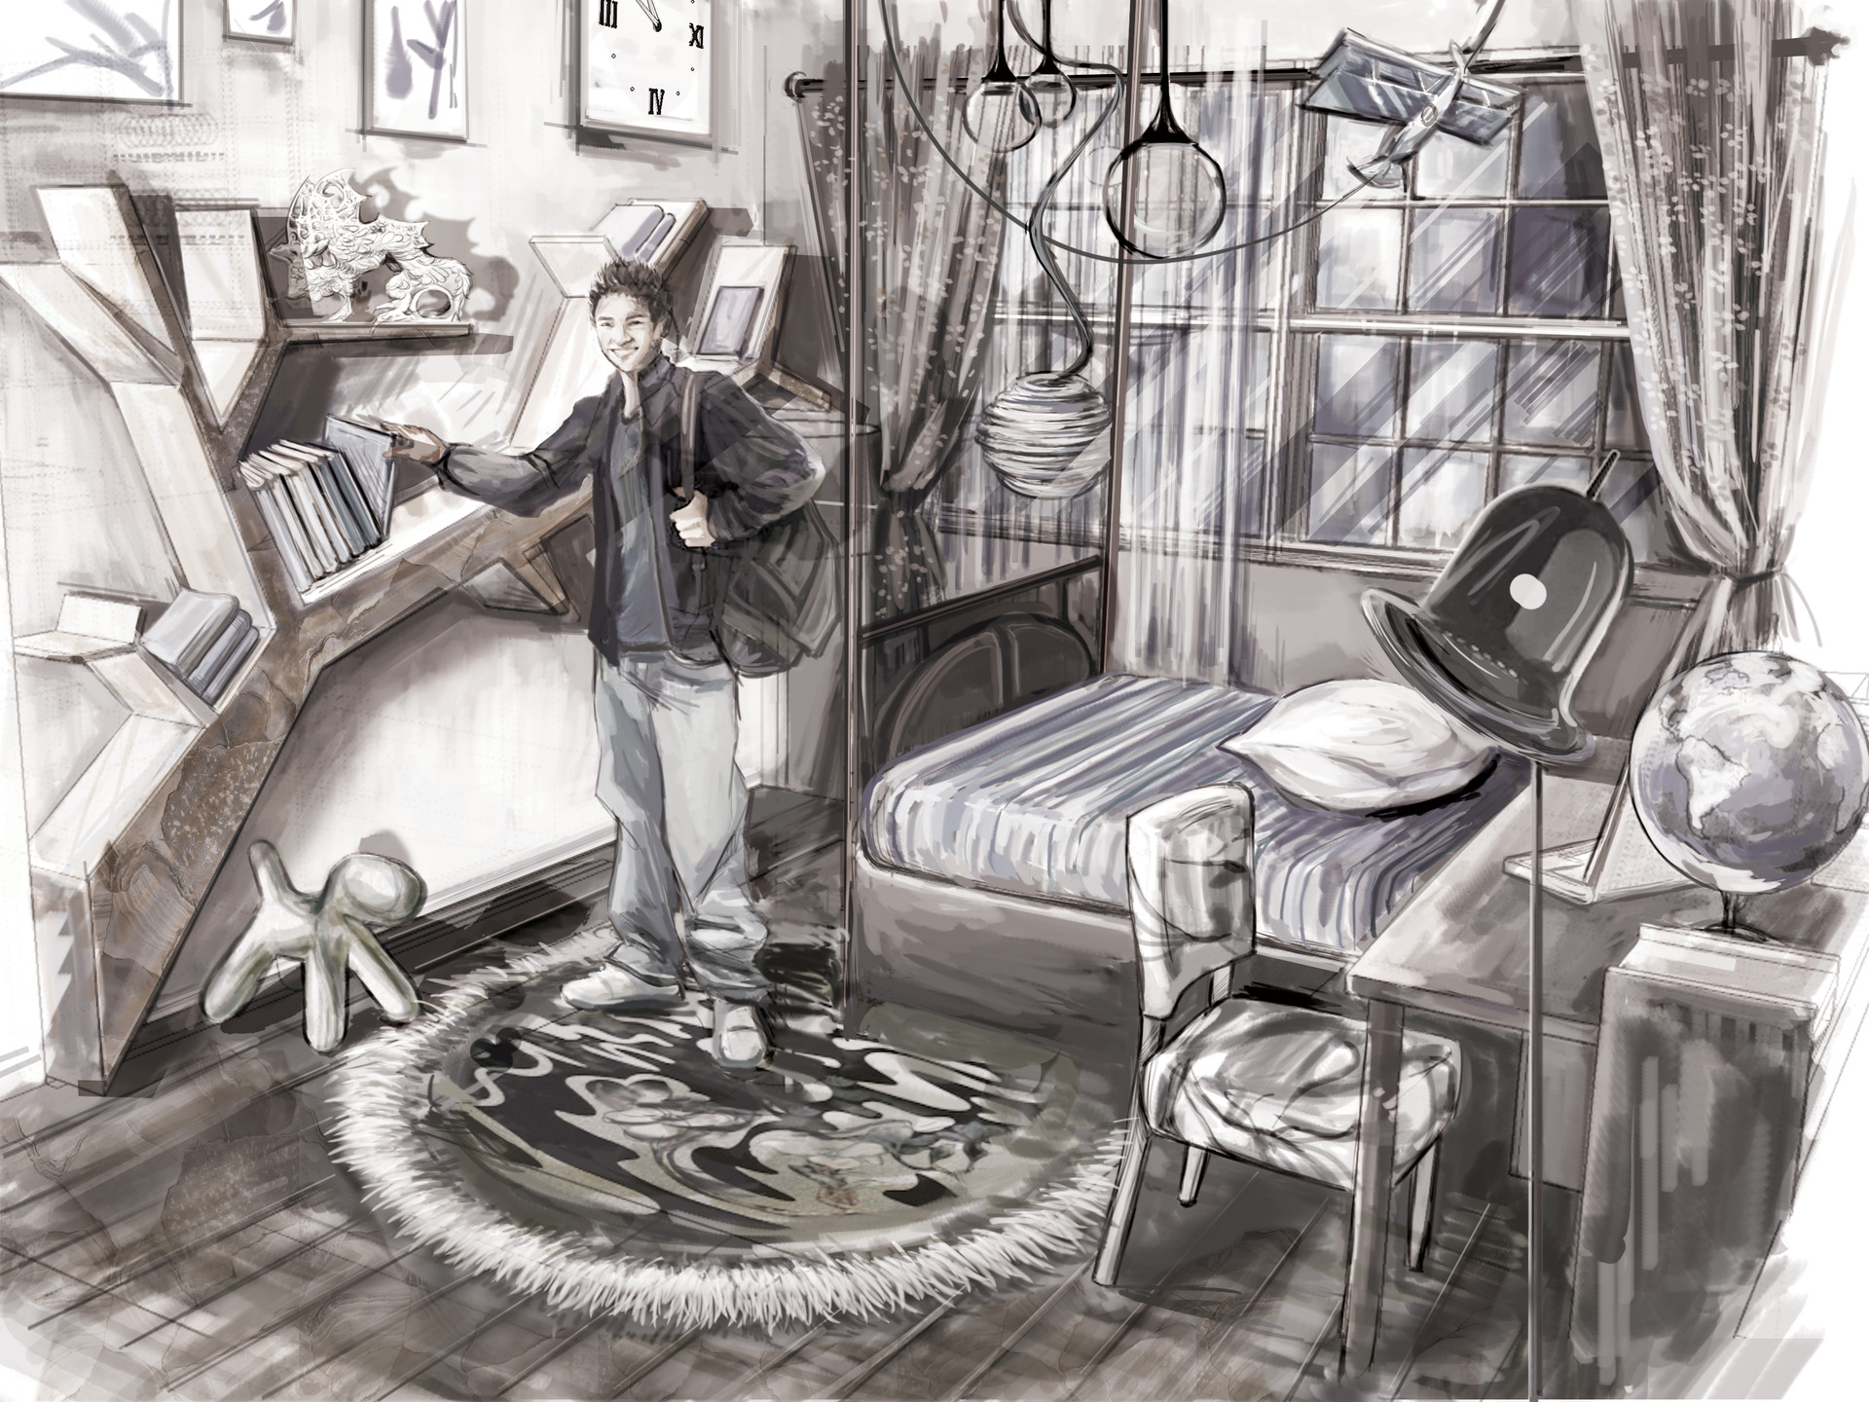
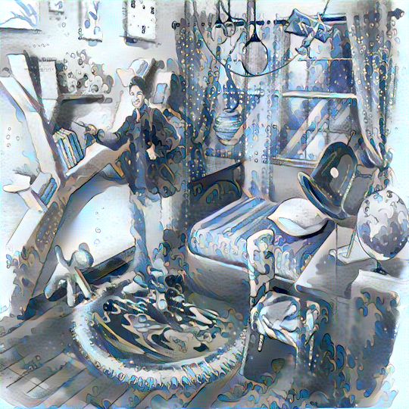
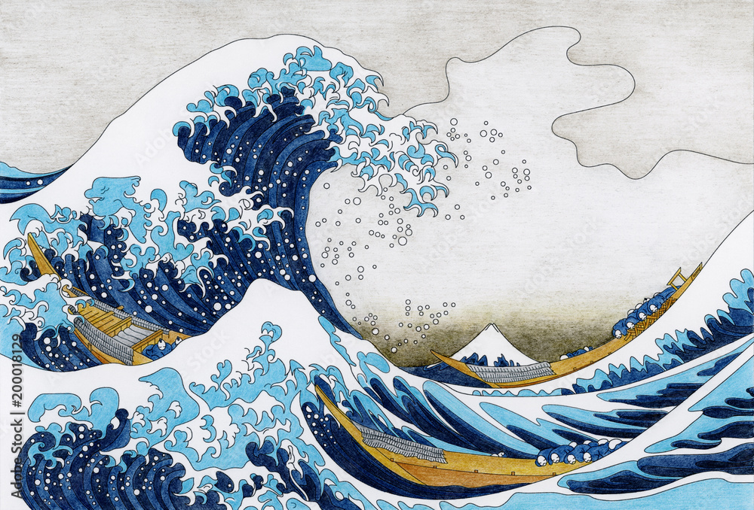

Slide 9
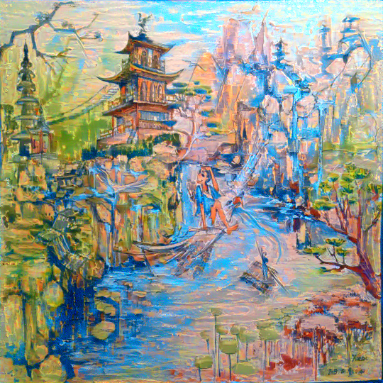


Slide 10
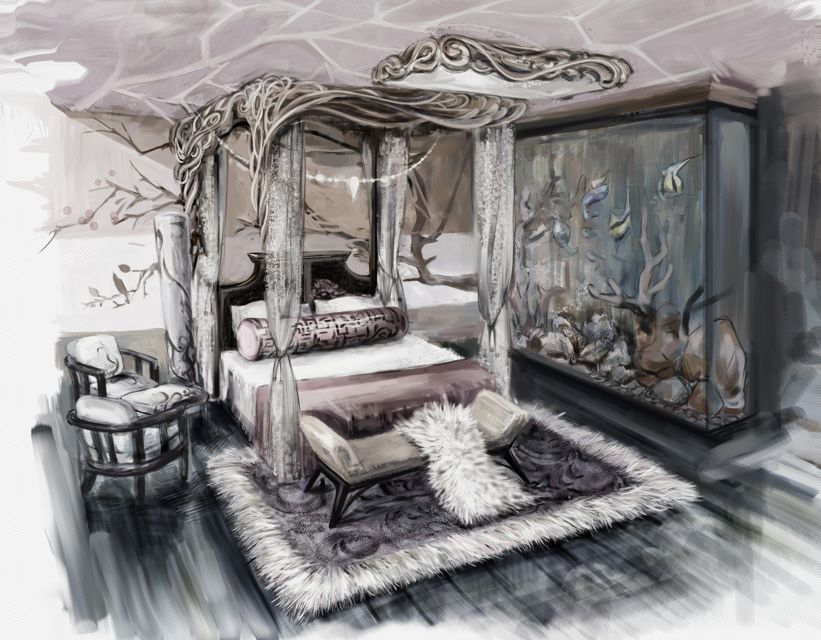
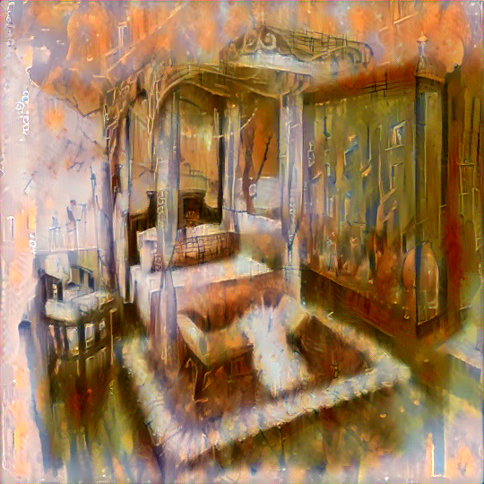


Slide 11
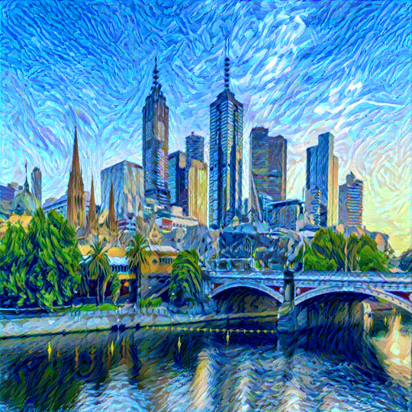

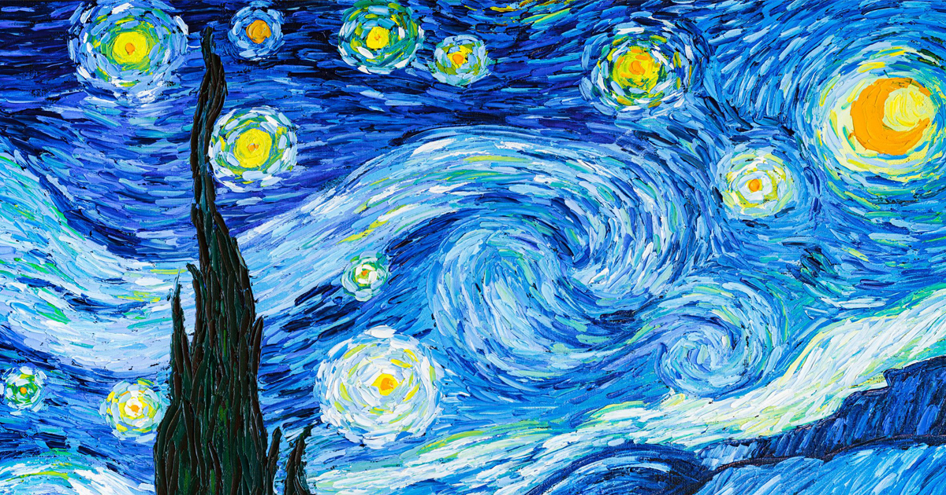

Slide 12
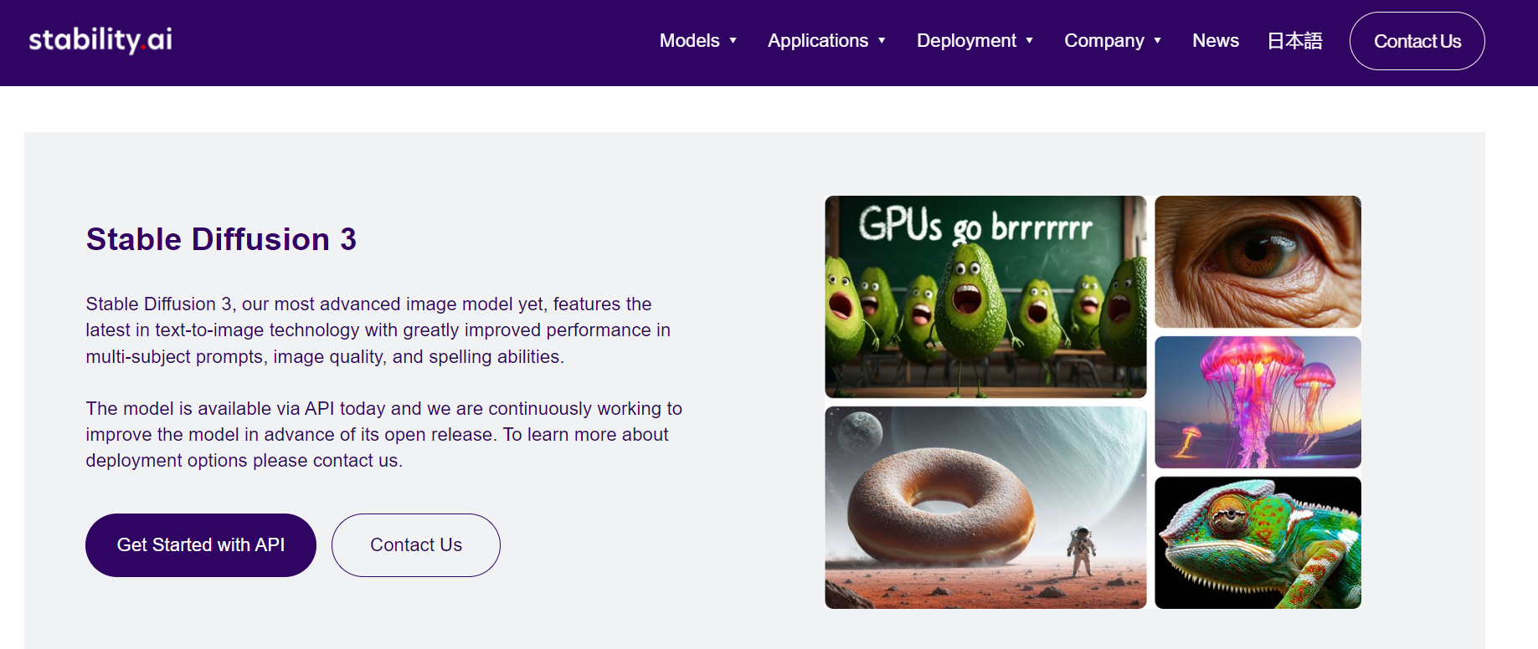

Slide 13
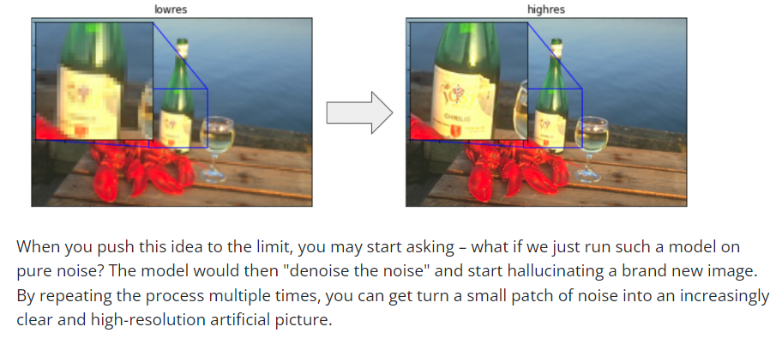
Stable Diffusion:
Stable Diffusion is a deep learning, text-to-image model released in 2022 based on diffusion techniques. Stable Diffusion consists of three parts:
A text encoder, which turns your prompt into a latent vector.
A diffusion model, which repeatedly "denoises" a 64x64 latent image patch.
A decoder, which turns the final 64x64 latent patch into a higher-resolution 512x512 image.
The model uses its training data distribution to hallucinate the visual details that would be most likely given the input.

Slide 14
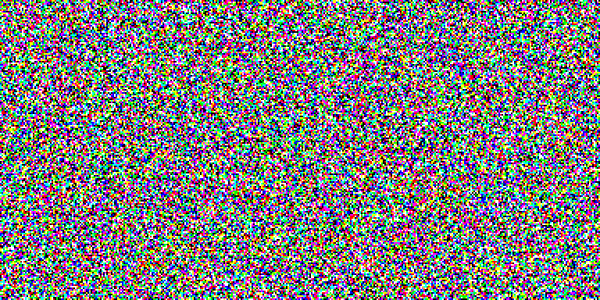
Denoising

Slide 15
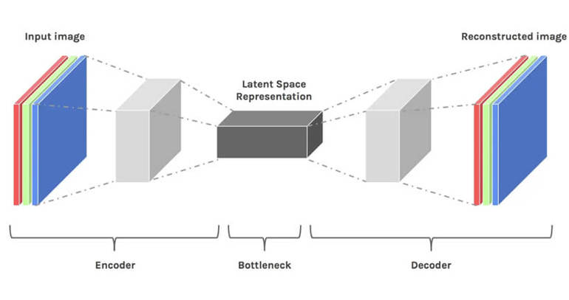
General Latent Diffusion Model Structure

Slide 16
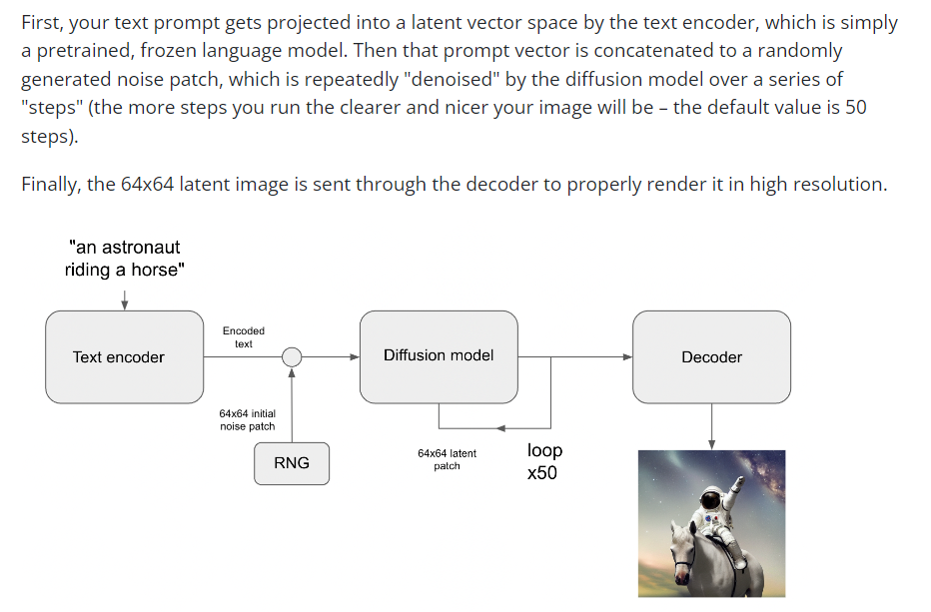
Actual Stable Diffusion Architect:

Slide 17
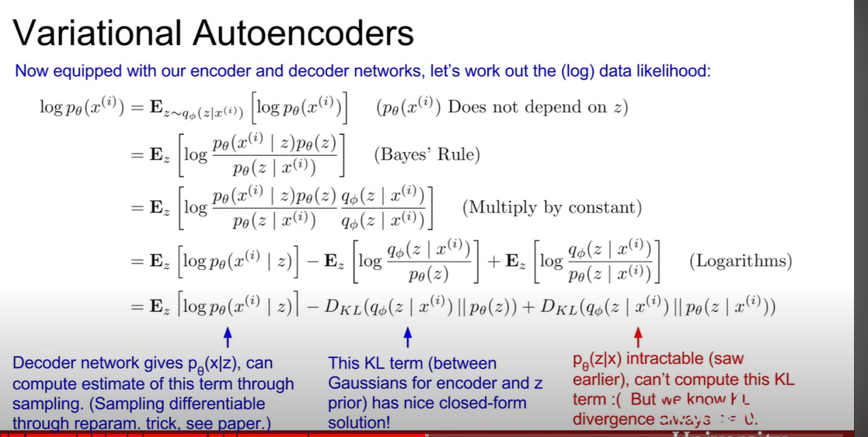

Slide 18
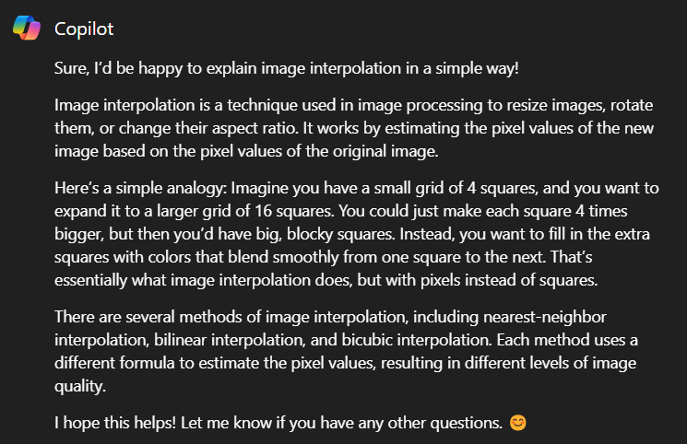
Image Interpolation with Stable Diffusion

Slide 19


Slide 20
Thank You!

